Slide 2







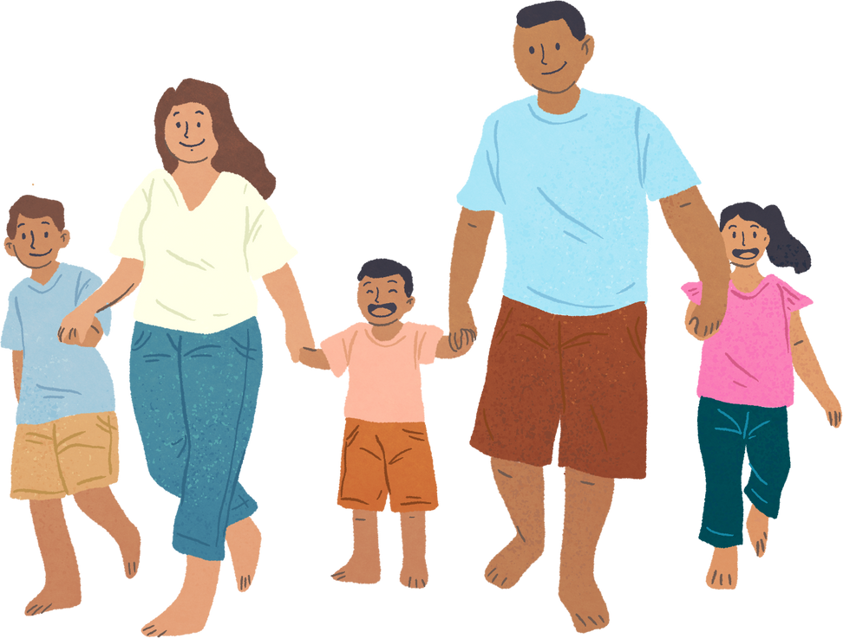


Unit 11: FAMILY TIME
Lesson 3 - Period 6

Slide 3






Table of contents
Warm-up and Review.
Activity 4: Read and answer.
Activity 5: Let’s write.
Activity 6: Project.
Fun corner and Wrap-up.

Slide 4








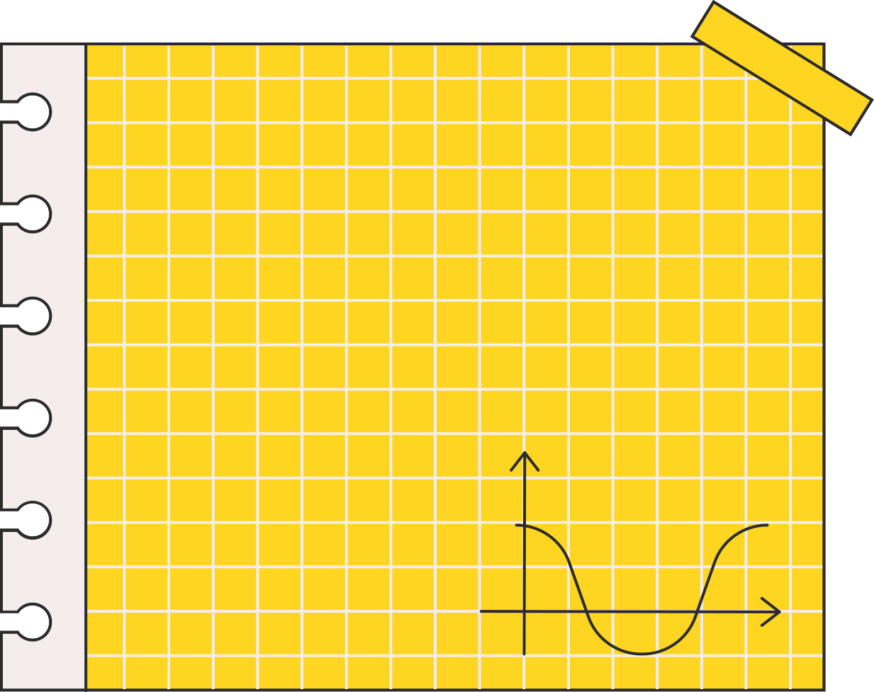



Warm-up and Review.
Let’s chant.

Slide 5





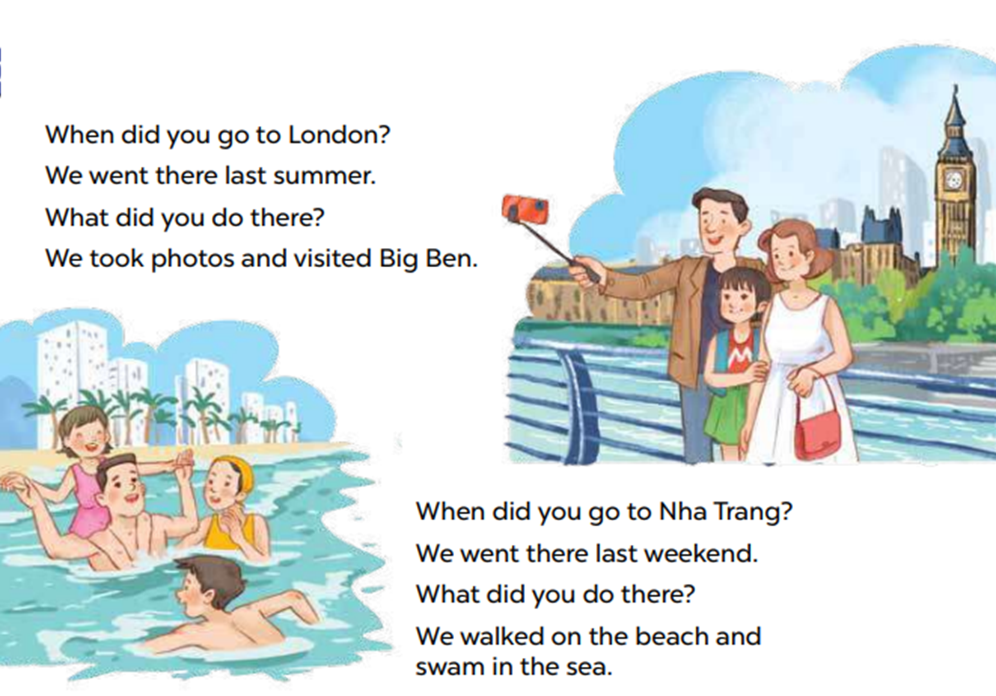


Let’s chant.

Slide 6

01
Activity 4
Read and answer.

Slide 7


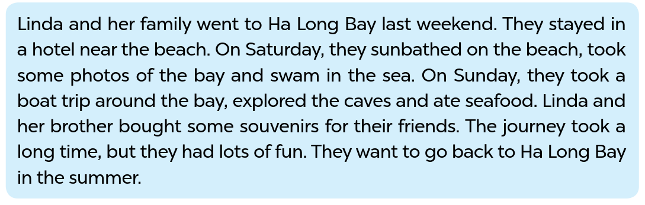
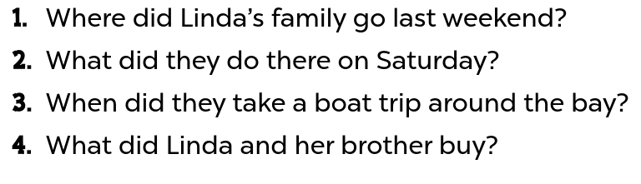


Look and read.
Notes:
Step 1: Have pupils read the questions carefully. Tell them to read Question 1 and pay attention to key words such as Where, Linda’s family, go. Then they should scan the text for relevant information.

Slide 8
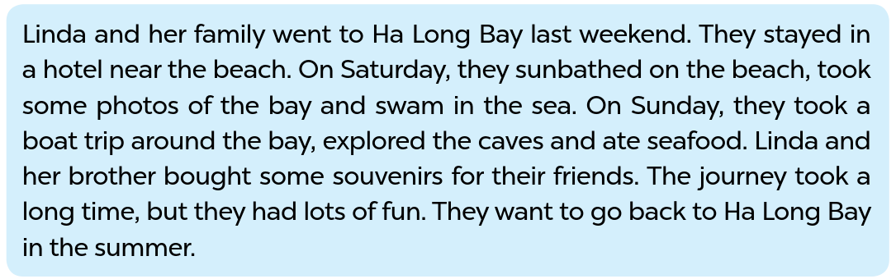
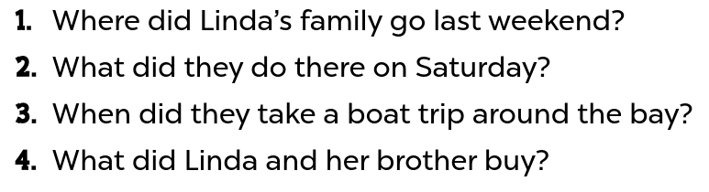
Read and answer.
Notes:
Step 2: Repeat Step 1 for Questions 2, 3 and 4. Set a time limit for pupils to do the task independently. Go around the classroom and offer help where necessary.

Slide 9
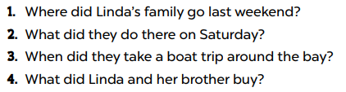

Swap your book.
Notes:
Step 3: Get pupils to swap books with their partners and check the answers before checking as a class.

Slide 10
Read and answer.
They went to Ha Long Bay.
They sunbathed, took some photos and swam in the sea.
They took a boat trip around the bay on Sunday.
They bought some souvenirs for their friends.
Notes:
Step 3: Get pupils to swap books with their partners and check the answers before checking as a class.

Slide 11
Ask and answer.
They went to Ha Long Bay.
They sunbathed, took some photos and swam in the sea.
They took a boat trip around the bay on Sunday.
They bought some souvenirs for their friends.
Notes:
Step 4: Invite some pairs to take turns asking and answering the questions.

Slide 12
03
Activity 5
Let’s write.

Slide 13



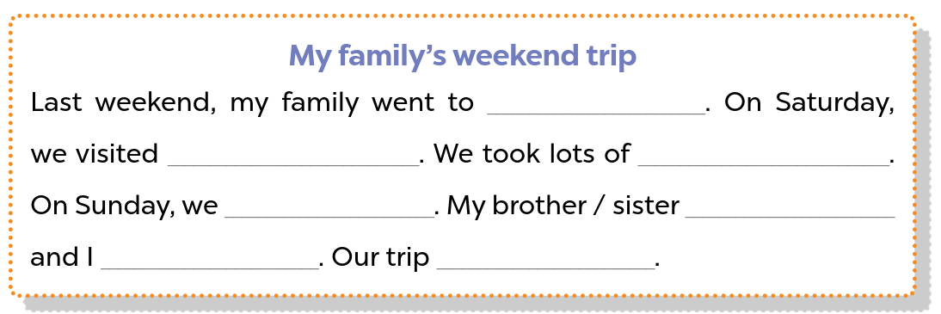


Look and say.
Notes:
Step 1: Ask pupils to read the gapped sentences and fill in the gaps with information about someone’s family’s weekend trip. Tell pupils that the gaps in the paragraph focus on their activities the previous weekend. Tell pupils that they should write about 40 words. Check comprehension.

Slide 14
Model the first gap.
Sa Pa
Notes:
Step 2: Have pupils do the first gapped sentence. Ask them to read the incomplete sentence and elicit where they went the previous weekend (for example, Sa Pa). Then have them write the first sentence (Last weekend, my family went to Sa Pa.)

Slide 15
Let’s write.
Sa Pa
Notes:
Step 3: Give pupils time to complete the paragraph independently. Go around the classroom and offer help if necessary.

Slide 16
Swap your book.
Notes:
Step 4: Get pupils to swap their books with a partner and check their spelling.

Slide 17
Suggested answer.
Last weekend, my family went to Sa Pa. On Saturday, we visited Sa Pa Town and went to see the mountains. We took lots of photos there. On Sunday, we went shopping in the town. My brother bought a shirt and I bought some souvenirs for my friends. Our trip was a lot of fun!

Slide 18
04
Activity 6
Project.

Slide 19


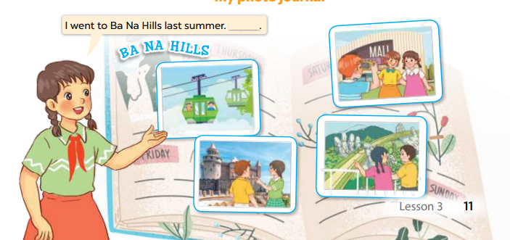



Ask and answer.
Notes:
Step 1: Explain that each pupil has to show his/her photo journal which includes some photos/ pictures of friends and their activities (they have prepared at home) and tell the class about where they went and what they did there.

Slide 20
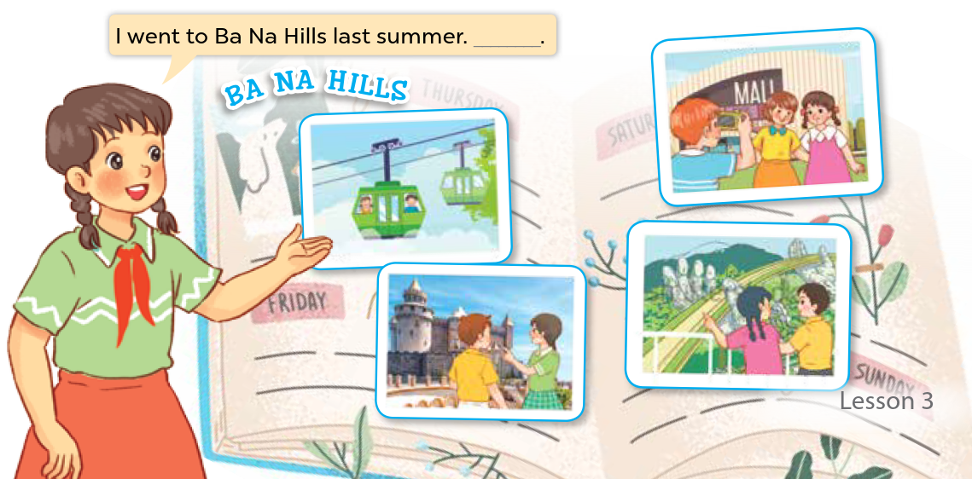
Work in groups.
Notes:
Step 2: Have pupils work in groups of five or six. Each pupil shows his / her photo journal to the group and describes what he/she and friends did somewhere last summer.

Slide 21
Presentation.
Notes:
Step 3: Invite a few pupils representing some groups to show their photo journals and tell the class about the activities of the friends in the photos/pictures, e.g. I went to Ba Na Hills last summer with my friends. We took the cable car. We visited Golden Bridge…

Slide 22
Give comments and praise.
Notes:
Step 4: Have the rest of the class give comments and praise pupils if they perform well.

Slide 23
05
Wrap-up
Let’s play a game.

Slide 24






RUNNING DICTATION

Slide 25




Hi everyone. Look at my photo journal. Last summer, I went to Ba Na Hills with my friends. We took a cable car to the centre of Ba Na Hills. We took a lot of photos there. We visited the beautiful buildings. We also went to see Golden Bridge in Da Nang. We had a lot of fun there.

Slide 26




Thank You For Playing!

Slide 27
Website: hoclieu.vn
Fanpage: https://www.facebook.com/tienganhglobalsuccess.vn/

