Slide 2

OUR SPECIAL DAYS
Lesson 1 - Period 1

Slide 3
Table of contents
1
2
3
4
Warm-up
Let's chant.
Activity 1
Look, listen and repeat.
Activity 2
Listen, point and say.
Activity 3
Let's talk.
Fun corner
5
Let's play.

Slide 4
01
Warm-up
Let's chant.

Slide 5
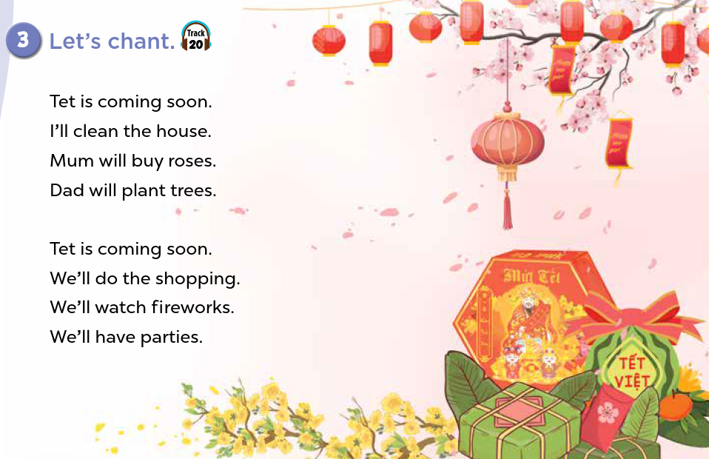


Slide 6
02
Activity 1
Look, listen and repeat.

Slide 7
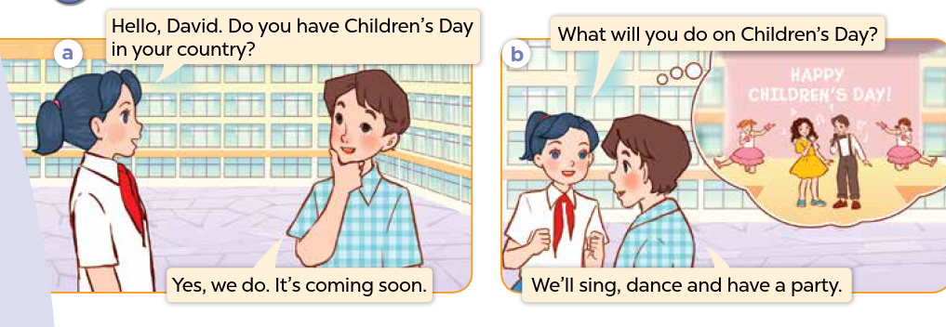
Who can you see? Where are they?
What are they talking about?

Slide 8
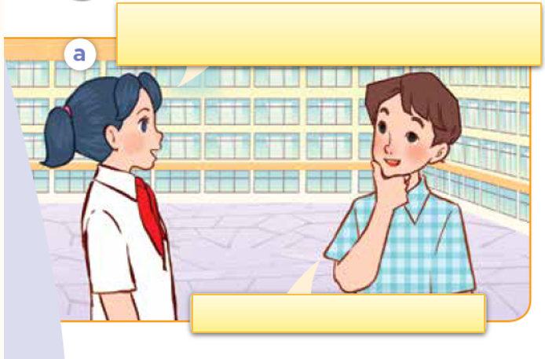
Look, listen and repeat.

Slide 9
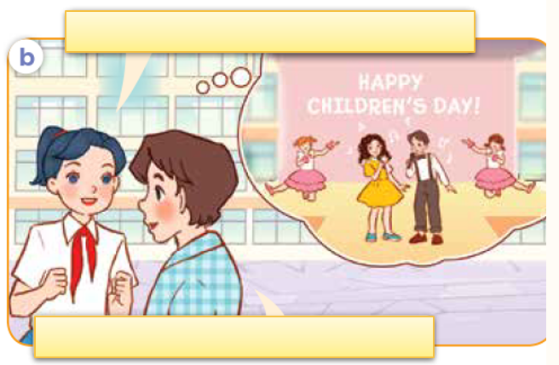
Look, listen and repeat.

Slide 10
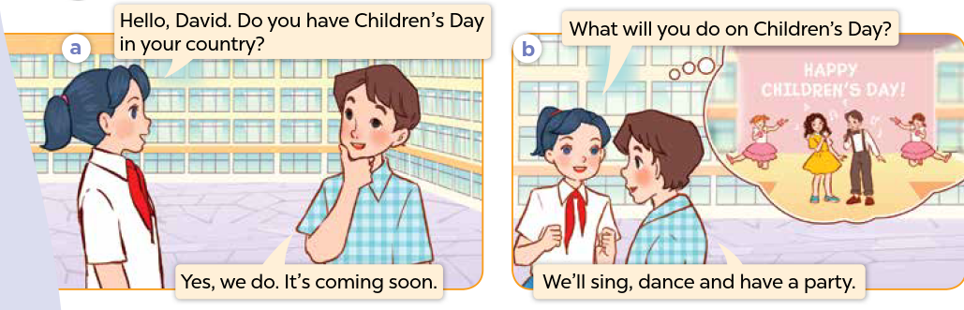
Look, listen, and repeat.

Slide 11
03
Activity 2
Listen, point and say.

Slide 12
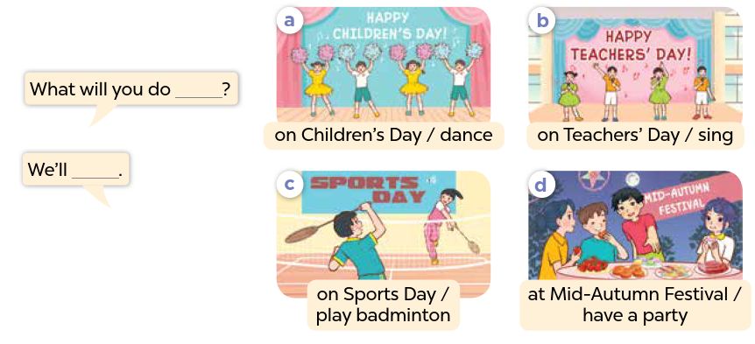

Slide 13
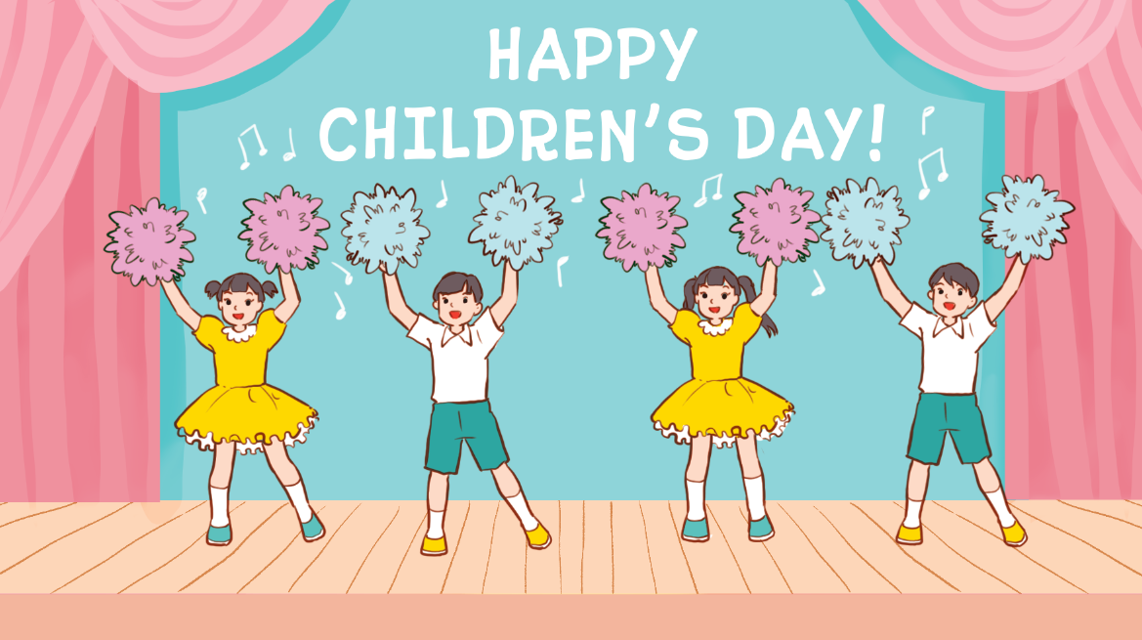
Listen, point and say.
a. On Children’s Day / dance

Slide 14
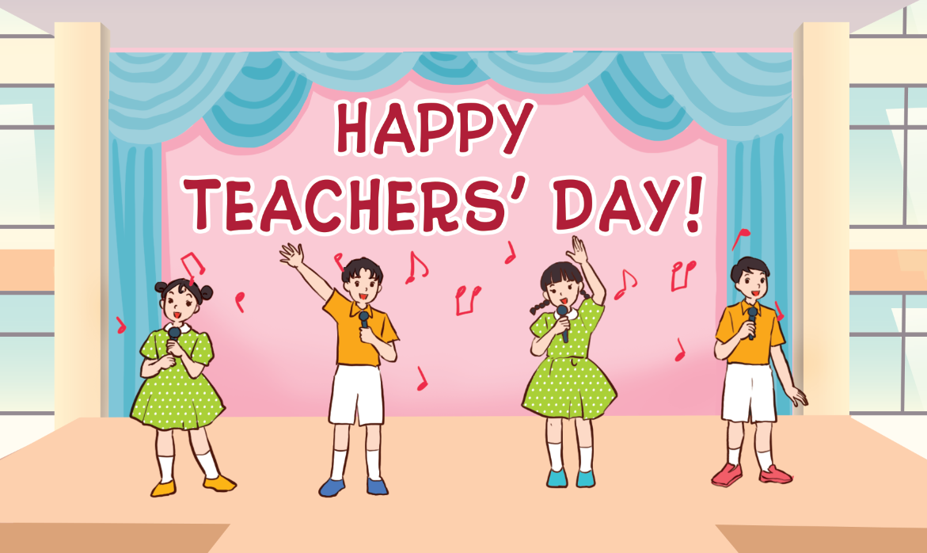
Listen, point and say.
b. on Teacher’s Day / sing

Slide 15

Listen, point and say.
c. on Sports Day / play badminton

Slide 16
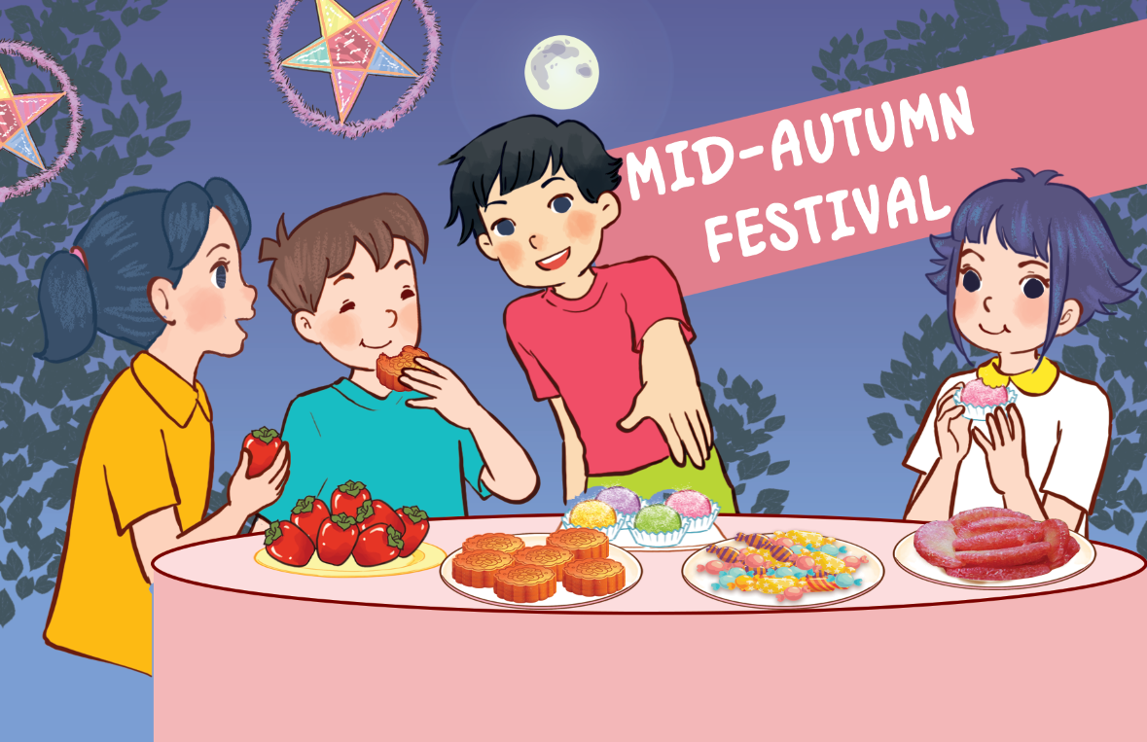
Listen, point and say.
d. at Mid-Autumn Festival / have a party

Slide 17
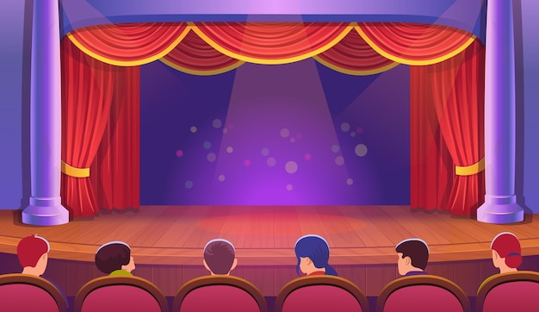
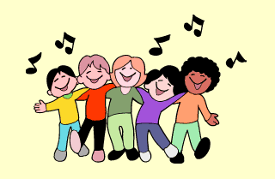
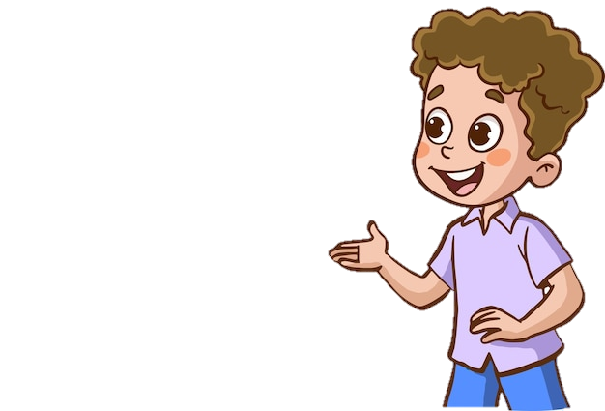
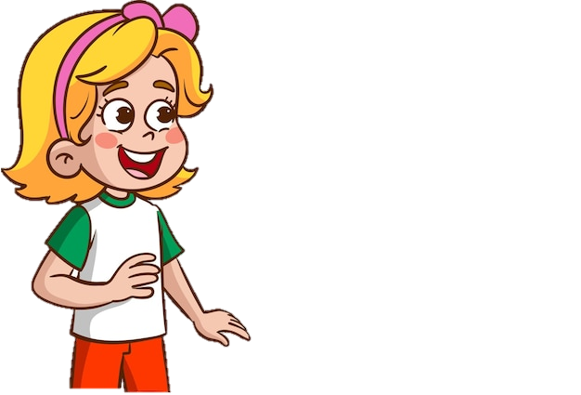
What will you do on Children's Day?
We'll sing.
HAPPY
CHILDREN'S DAY!

Slide 18
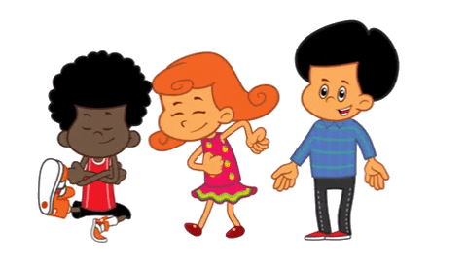
What will you do on Teachers' Day?
We'll dance.
HAPPY
TEACHERS' DAY!

Slide 19
What will you do ________?
We'll ____.

Slide 20
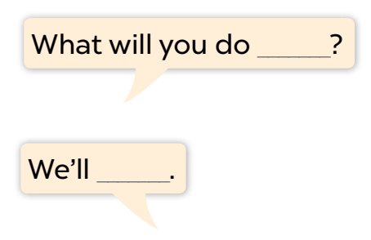
Listen, point and say.
a. On Children’s Day / dance

Slide 21
Listen, point and say.
b. on Teacher’s Day / sing

Slide 22
Listen, point and say.
c. on Sports Day / play badminton

Slide 23
Listen, point and say.
d. at Mid-Autumn Festival / have a party

Slide 24
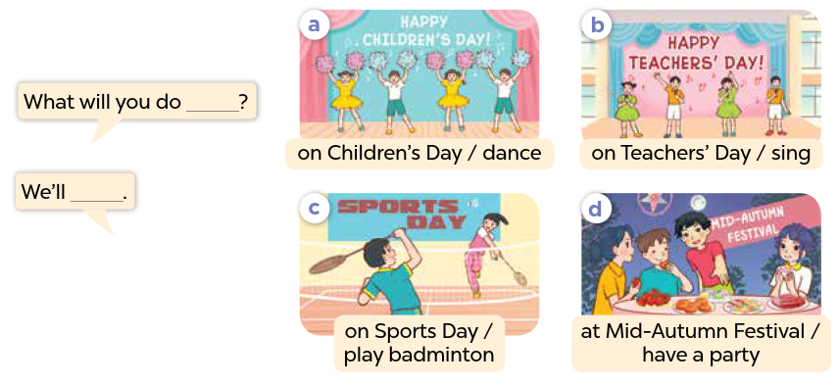
Work in pairs. Ask and answer.

Slide 25
Activity 3
04
Let's talk.

Slide 26
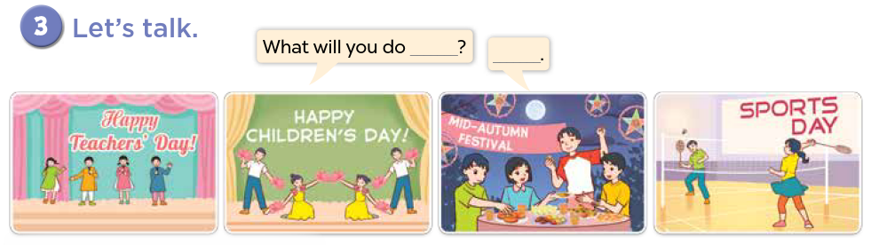

Slide 27
Fun Corner
05
SPIN THE WHEEL

Slide 28
Spin the wheel
3 JUMPING JACKS
1 STAR
5 STARS
3 STARS
SPIN AROUND
SAY AN ENGLISH WORD
Click here to spin
5 HIGH KNEES
NO STAR
-2 STARS
-5 STARS
3 SQUATS
10 STARS

Slide 29
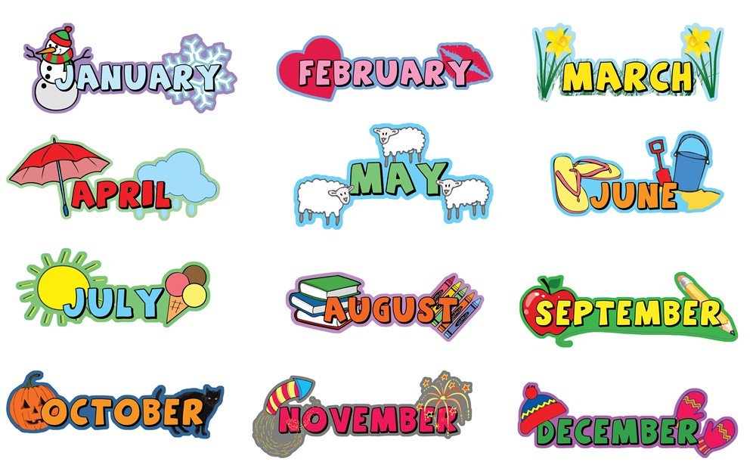
What's your favourite month?

Slide 30

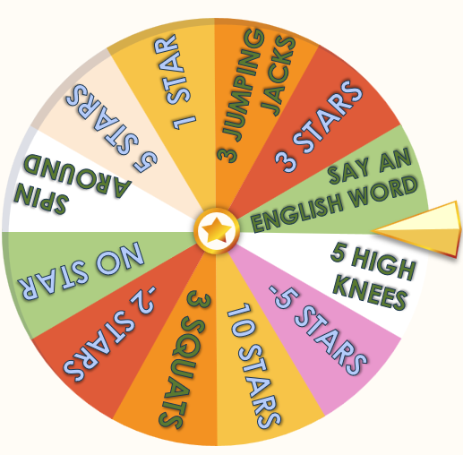
What day is June 1st?
It's Children's Day.

Slide 31

What day is November 20th?
It's Vietnamese Teachers' Day.

Slide 32
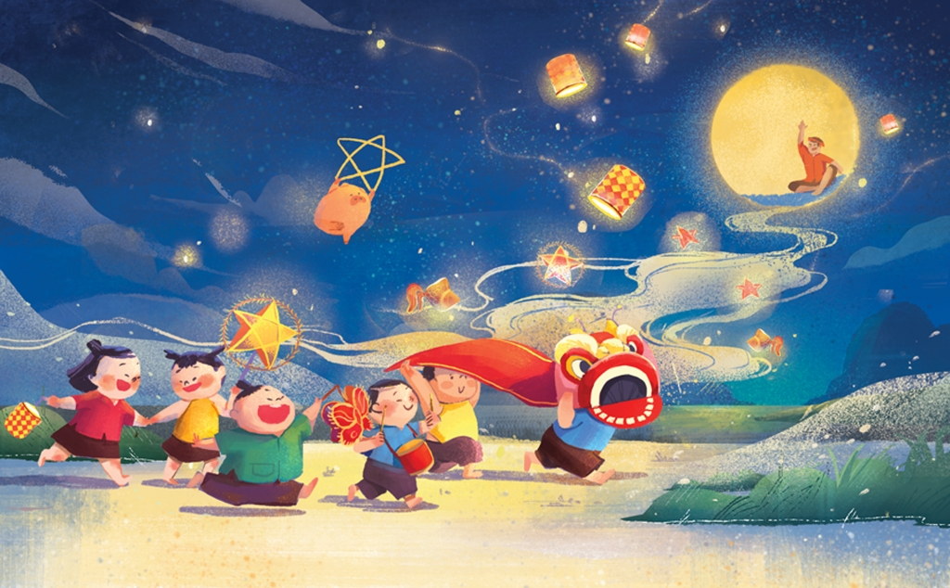
What festival is it?
It's Mid-Autumn Festival.

Slide 33
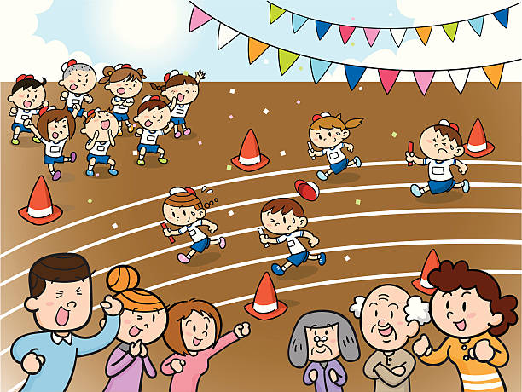
What day is it?
It's Sports Day.

Slide 34
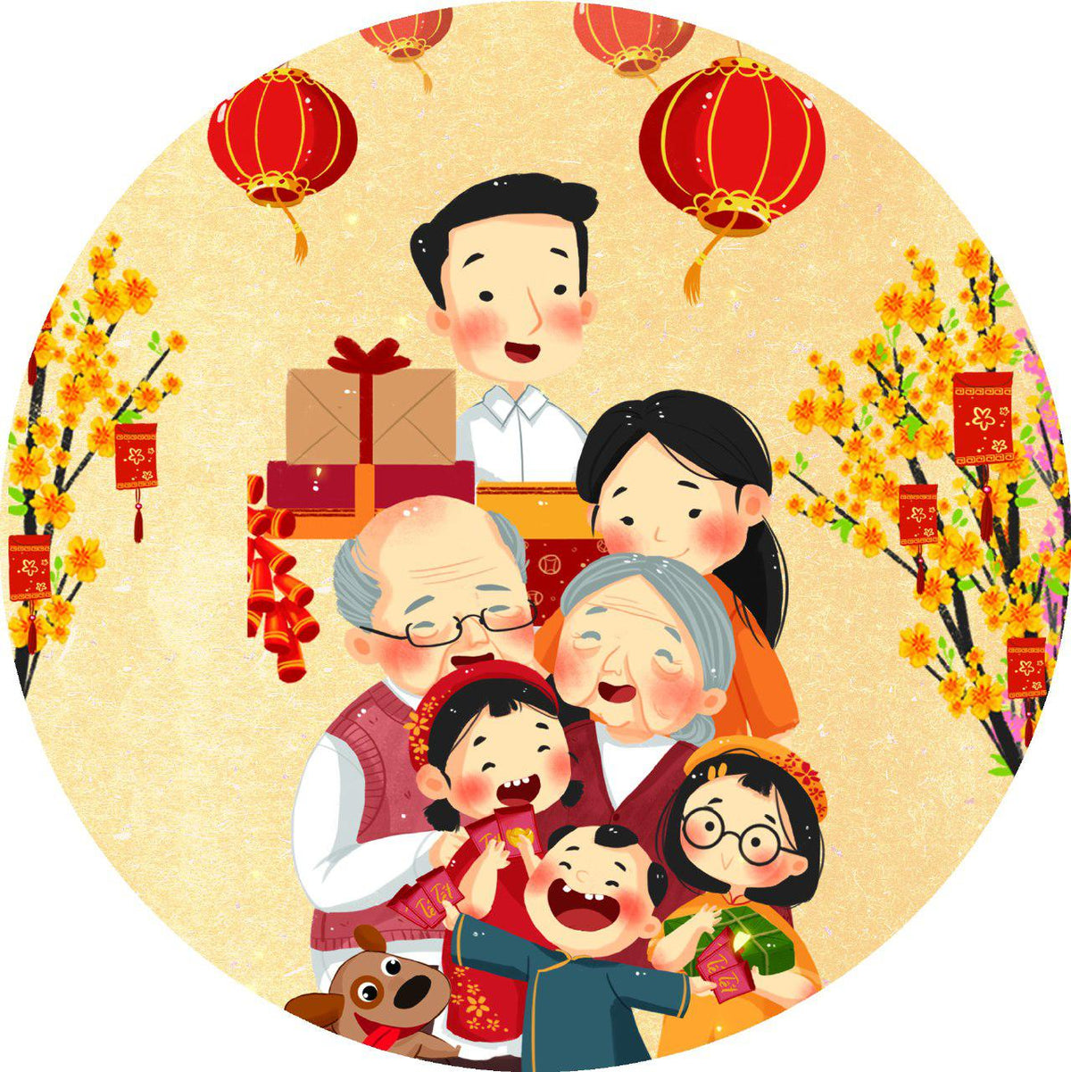
What festival is it?
It’s Tet Festival.
(Lunar New Year)

Slide 35
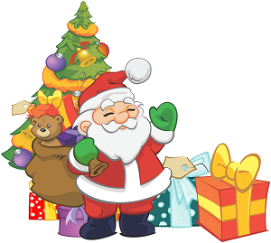
What day is it?
It's Christmas Day.

Slide 36
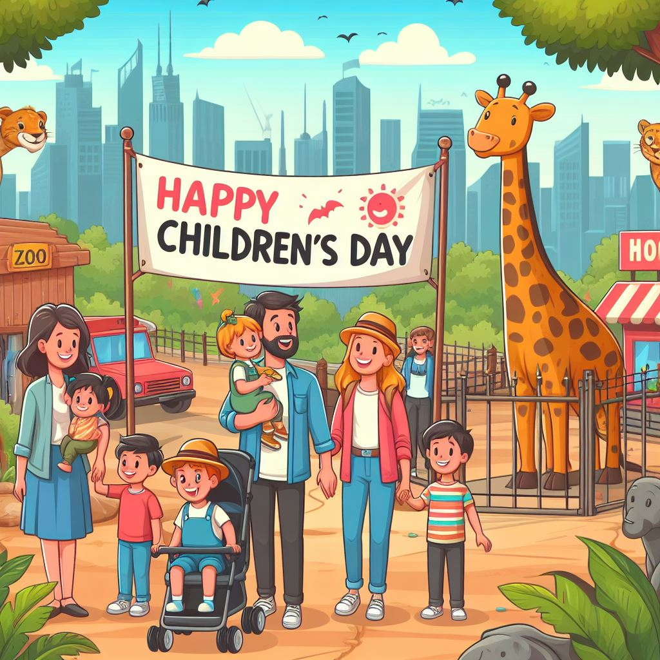
Ask and answer.
What will you do ___________?
on Children's Day
We'll ________.
go to the zoo

Slide 37

Ask and answer.
What will you do ___________?
'
on Teachers' Day
We'll _____.
sing

Slide 38
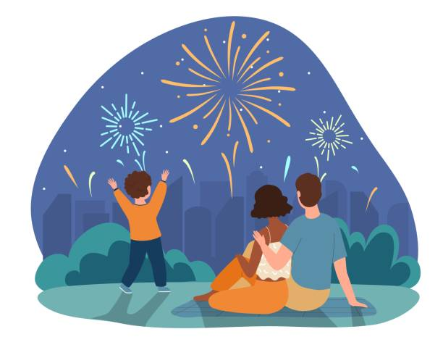
Ask and answer.
What will you do ___________?
at Tet Festival
___ watch _____.
We'll
fireworks

Slide 39
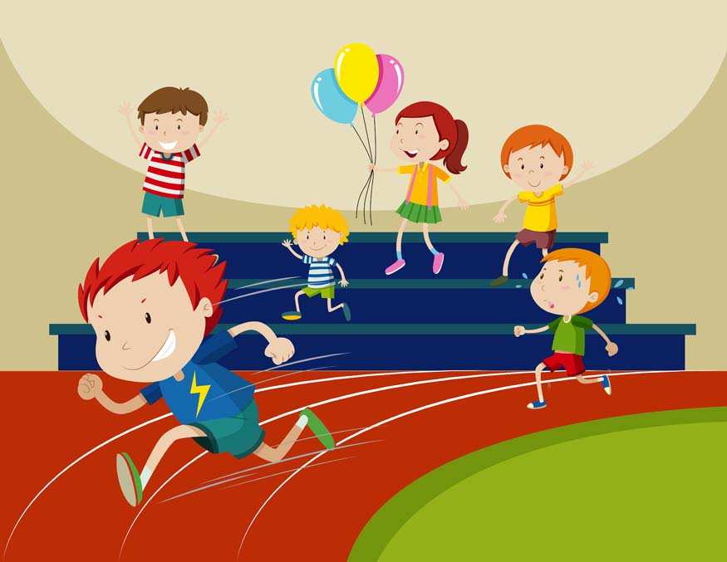
Ask and answer.
What will you do ___________?
on Sports Day
We'll _____.
run

Slide 40
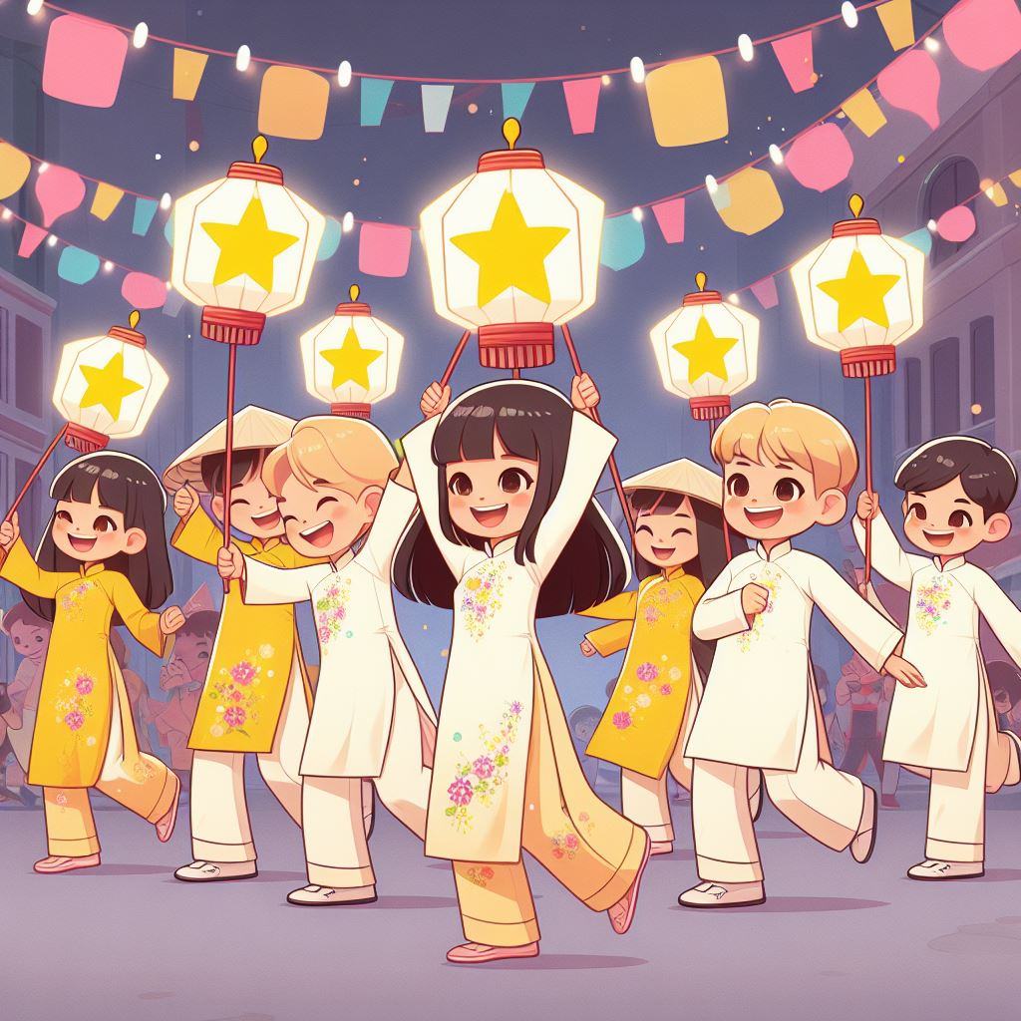
Ask and answer.
_________at Mid-Autumn Festival?
What will you do
______ dance and have fun.
We'll

Slide 41
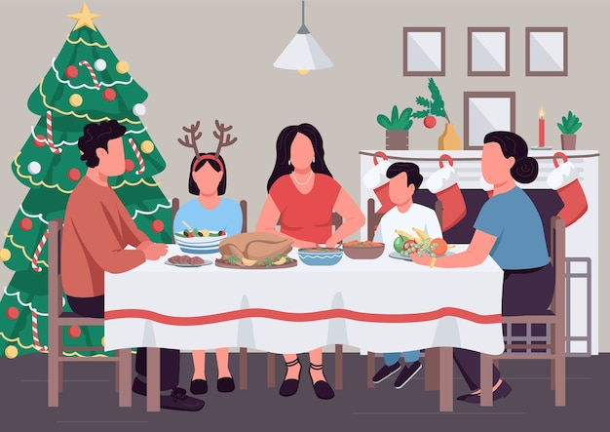
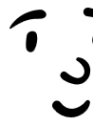




Ask and answer.
_________ on Christmas Day?
What will you do
___________.
We'll have a party

Slide 42
Website: hoclieu.vn
Fanpage: https://www.facebook.com/tienganhglobalsuccess.vn/

