Slide 2

OUR SPECIAL DAYS
Lesson 3 - Period 6

Slide 3
Table of contents
1
2
3
4
Warm-up
Activity 1
Read and answer.
Activity 2
Let’s write.
Activity 3
Project.
Fun corner
5
Let's play.

Slide 4
01
Warm-up

Slide 5

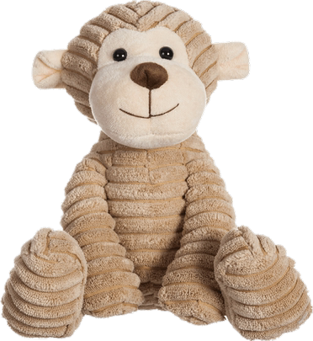
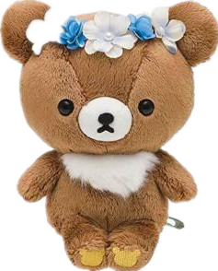
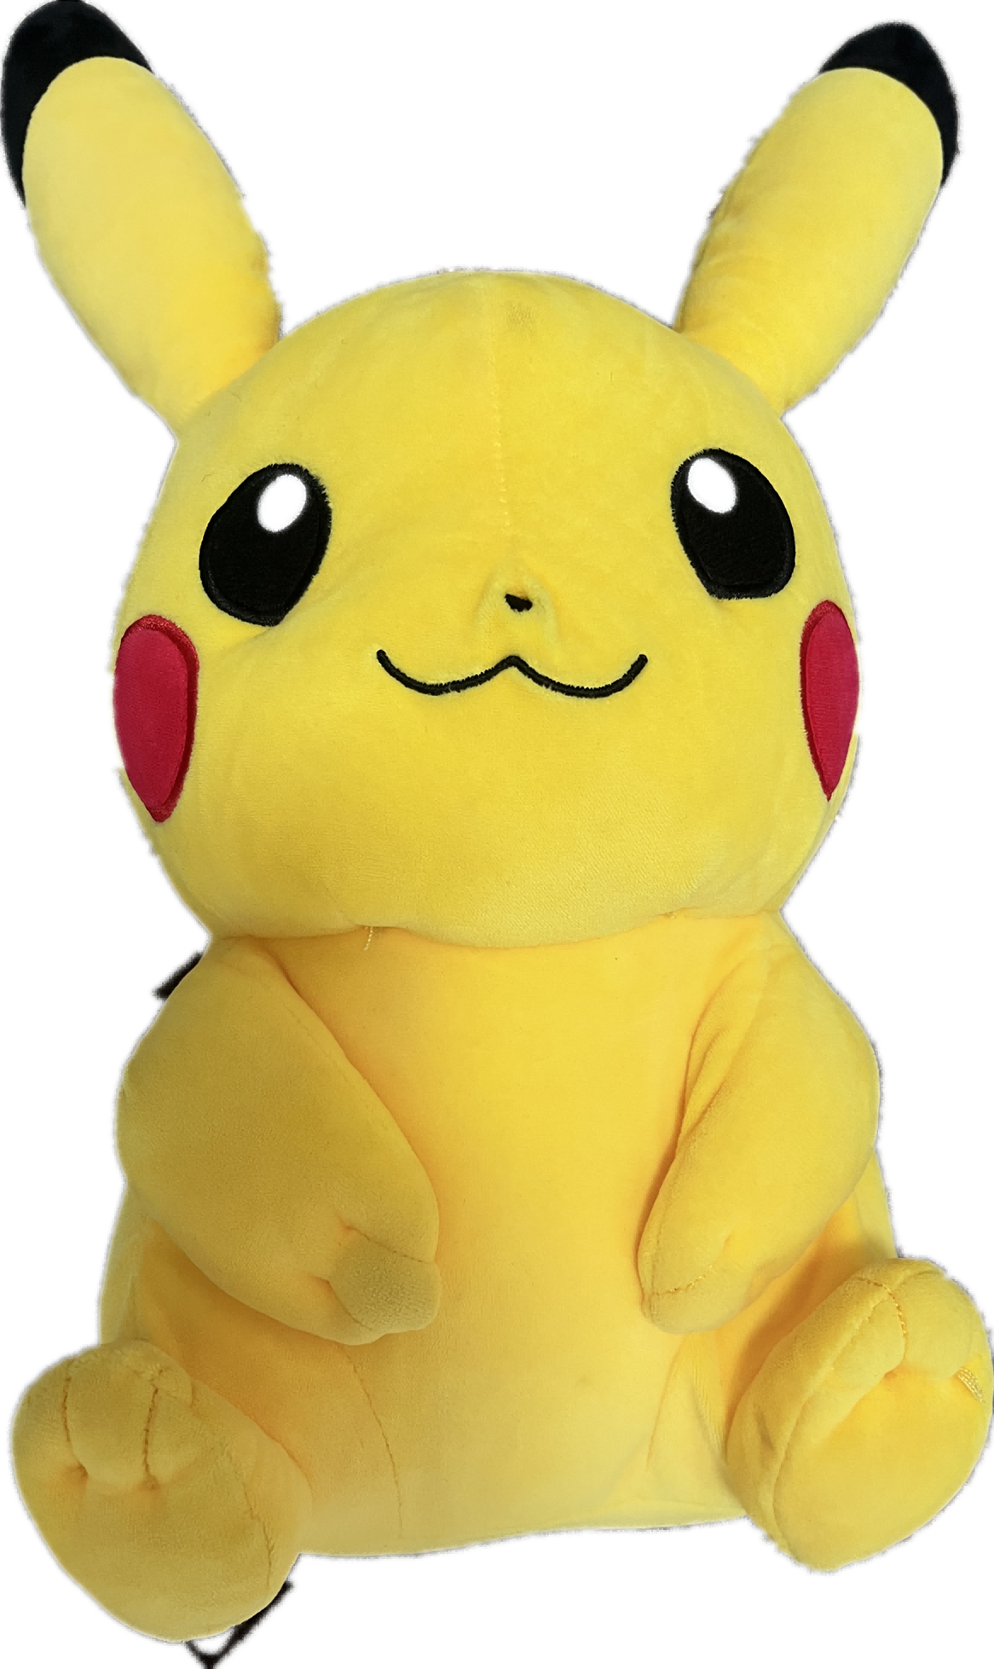
pizza
I will have ………… .
pizza
burger
lemonade

Slide 6

milk tea.
We will have …………….
lemonade
juice
milk tea

Slide 7
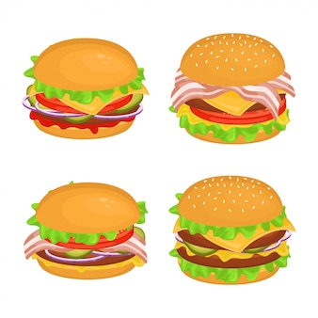
burgers
I will have ………………
cake
burgers
pizza

Slide 8

dance
We will ………………
play
sing
dance

Slide 9

party
I will have a ……………..
party
apple juice
burgers

Slide 10

sing
We will ………..
dance
sing
play

Slide 11
02
Activity 1
Read and answer.

Slide 12
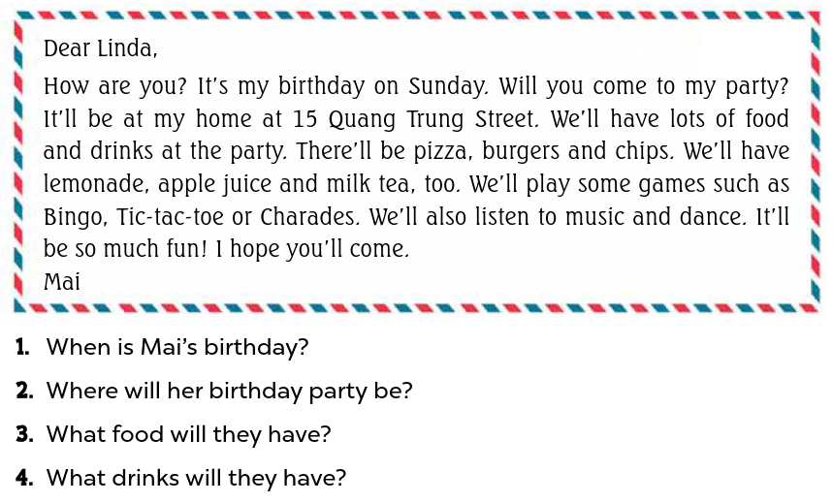
Read the question and underline keywords.

Slide 13
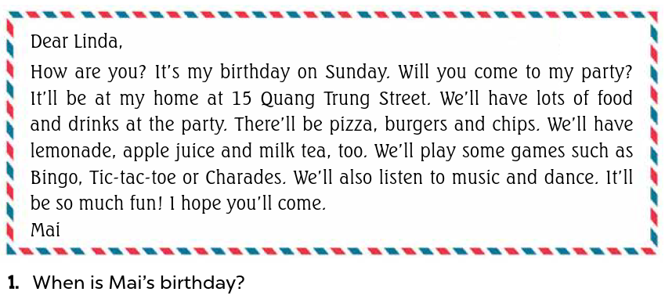
Look at Question 1.
Mai’s birthday / It is on Sunday.

Slide 14
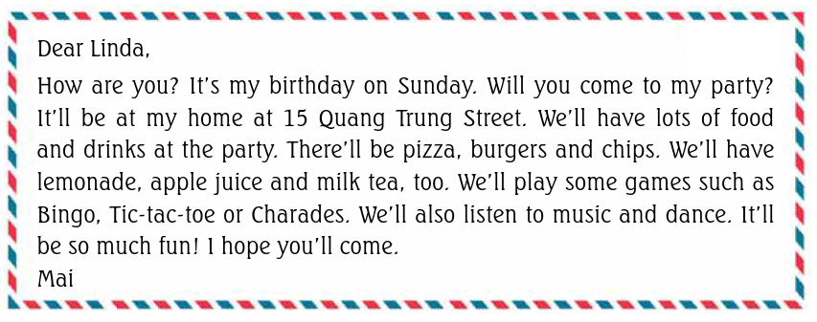
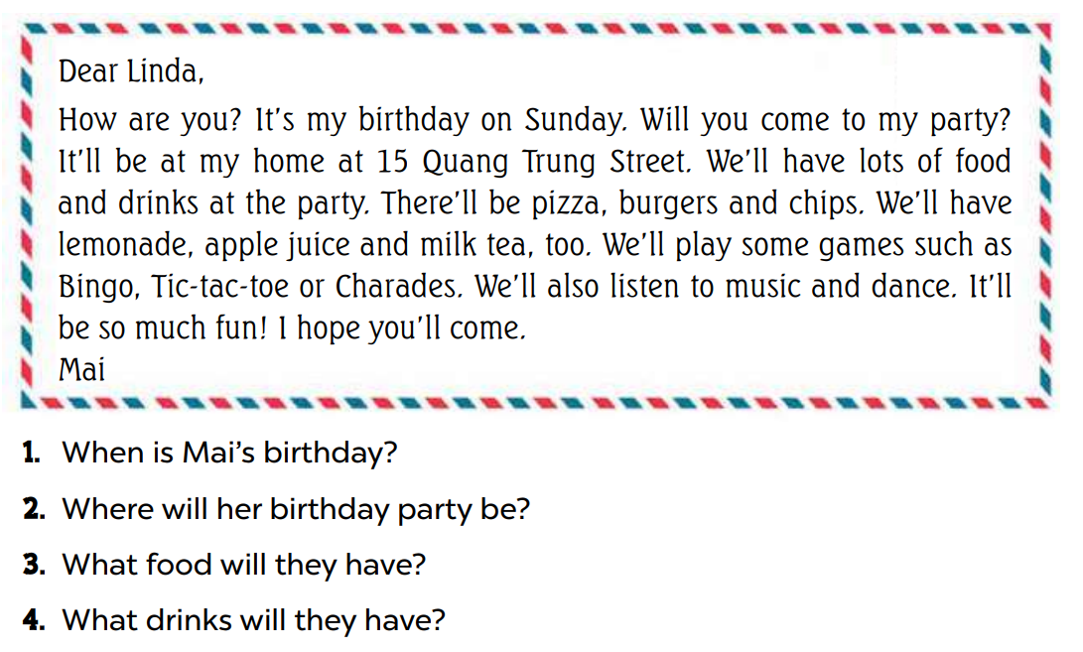
Her birthday party / It will be at 15 Quang Trung Street.

Slide 15
They’ll have pizza, burgers and chips.

Slide 16
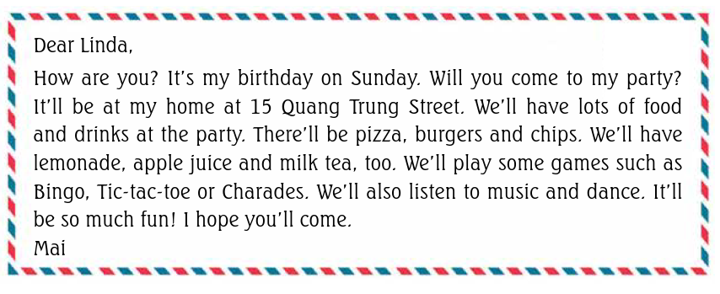
They’ll have lemonade, apple juice and milk tea.

Slide 17
03
Activity 2
Let’s write.

Slide 18
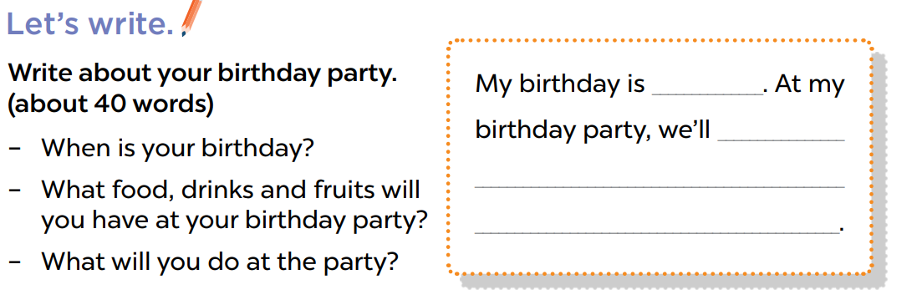
Work in pairs. Ask and answer the question.
Look and write.

Slide 19
My birthday is in May.
I will have pizza, chicken, milk tea and lemonade …
I will sing and dance.
in May
have pizza,
chicken, milk tea and lemonade…
We will sing and dance.

Slide 20
Let’s write.

Slide 21
Activity 3
04
Project

Slide 22
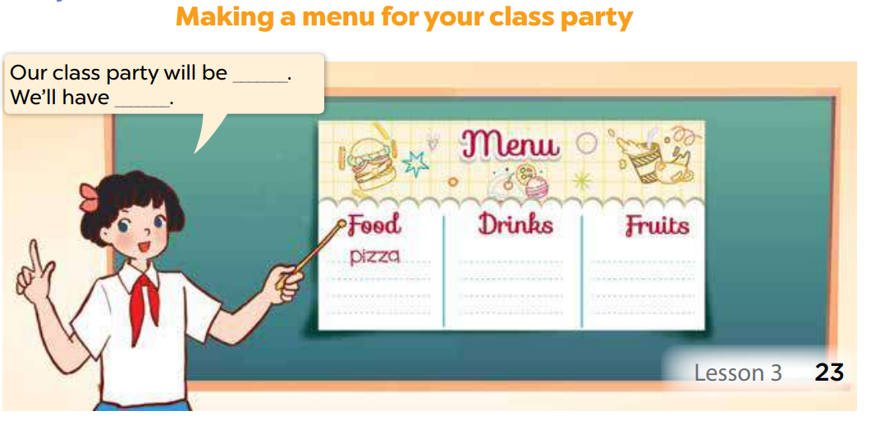
Take out the menu prepared at home
Work in groups. Let’s talk.

Slide 23
Fun Corner
05
Play the game.

Slide 24




1
2
3
4
5
7
8
6
Notes:
Click the numbers to go to the questions

Slide 25



be
Our class party will ……………… next Saturday.

Slide 26
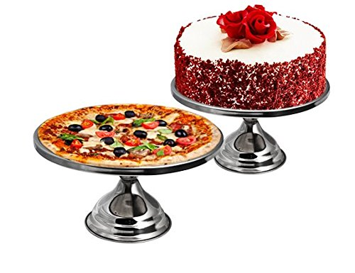
We’ll have cake and ……………...
pizza

Slide 27

will
We …………… have lemonade and apple juice.

Slide 28


We will have chips and ……………….
burgers

Slide 29

food
What ………….. will you have at the party?
We’ll have pizza, chips and burgers.

Slide 30

drinks
What ………….. will you have at the party?
We’ll have fruit juice.

Slide 31

sing/ We/ and/ will/ dace./
We will sing and dance.

Slide 32


drink/ juice./ will/ milk tea/ and/ apple/ We/
We will drink milk tea and
apple juice.

Slide 33
Website: hoclieu.vn
Fanpage: https://www.facebook.com/tienganhglobalsuccess.vn/

