Slide 2





Let’s learn
EXTENSION ACTIVITY
3

Slide 3

TABLE OF CONTENTS
  Warm-up and Review
  Activity 3: Read and match.
  Activity 4: Read and tick True or False.
  Activity 5: Let’s write.
  Fun corner and Wrap-up

Slide 4

1.
Warm-up and Review
LET'S START!

Slide 5



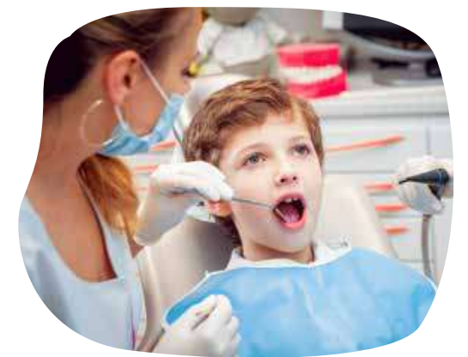
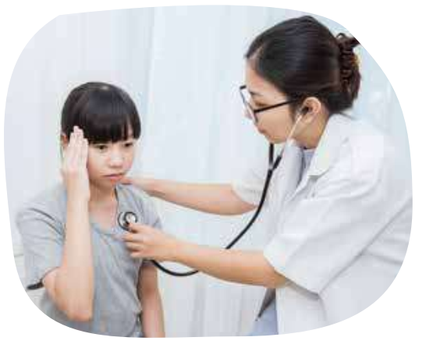


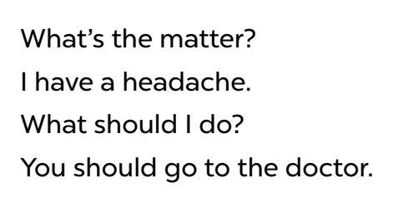
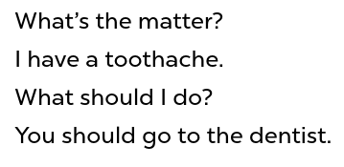


Listen and chant.

Slide 6

Good Job!
Congratulations!

Slide 7
2.
Activity 3
Read and match.
LET'S START!

Slide 8











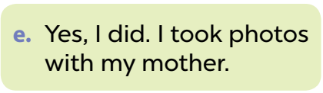
Look and read.
Notes:
Step 1: Draw pupils’ attention to the sentences. Tell them how to do the activity. Point at Sentence 1, elicit the answer and give feedback. Draw a line to match Sentence 1 with the letter e.

Slide 9
Read and match.
Notes:
Step 2: Give pupils time to do the task. Go around the classroom to offer support.

Slide 10

Swap your books and check your answers.
Notes:
Step 3: Get pupils to swap books with a partner.

Slide 11
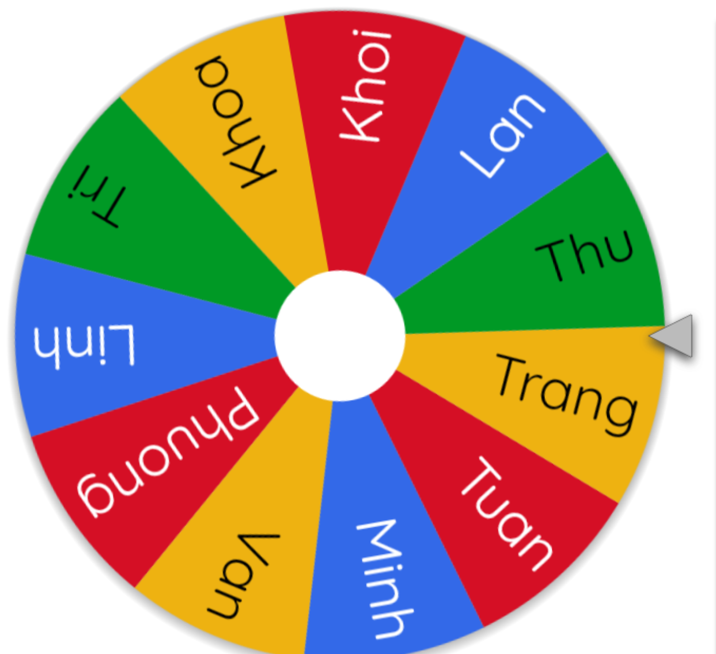
Let’s spin.
Notes:
Extension: Invite pairs of pupils to stand up and read the matched exchanges aloud.

Slide 12
Let’s check.
Notes:
Check answers together as a class. Write the correct answers on the board.

Slide 13
Good Job!
Congratulations!

Slide 14
3.
Activity 4
Read and tick True or False.
LET'S START!

Slide 15
Listen and read.
1. What’s the festival?
2. Where will the children have the party this year?
3. Who will dance at the party?
4. Who will sing songs?
5. What will the children eat?
6. What will the children drink?
7. What will the children get at the end of the party?
Notes:
Tell pupils that they are going to read a paragraph. Then have them to focus on these questions::
What’s the festival?
Where will children have a party this year?
Who dance at the party?
Who will sing song?
What will children eat?
What will children drink?
What will the children get at the end of the party?

Slide 16
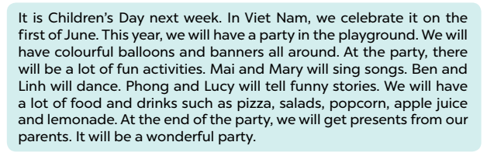







Listen and say.
page 37
Notes:
Step 1: Get pupils to read the paragraph. Check comprehension with the questions.

Slide 17



Read and tick True or False.
The Children Day’s party will be in the playground.
True
Notes:
Step 2: Have pupils read all the sentences under the paragraph. Tell them to read Sentence 1 and pay attention to the keywords Children’s Day party and in the playground, then scan the paragraph for the information.

Slide 18
Read and tick True or False.
The Children Day’s party will be in the playground.
TRUE | FALSE
✓
Notes:
If it is the same, they should put a tick in the True box. If the information is not the same, they should put a tick in the False box.

Slide 19
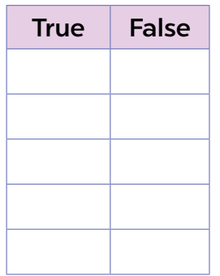
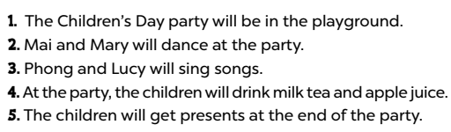
page 37
Read and tick True of False.
✓
Notes:
Step 3: Repeat Step 2 for Sentences 2, 3, 4 and 5. Set a time limit for pupils to do the activity independently. Go around the classroom and offer help where necessary.

Slide 20
Swap your books and check your answers.
Notes:
Step 4: Get pupils to swap books with their partners and check their answers before checking as a class.

Slide 21




Let’s check.
2. Mai and Mary will dance at the party.
False
Notes:
*Key:
1. True
2. False
3. False
4. True
5. True

Slide 22
Read and tick True or False.
2. Mai and Mary will dance at the party.
TRUE | FALSE
✓
✓
Notes:
*Key:
1. True
2. False
3. False
4. True
5. True

Slide 23



Let’s check.
3. Phong and Lucy will sing songs.
False
Notes:
*Key:
1. True
2. False
3. False
4. True
5. True

Slide 24
Read and tick True or False.
3. Phong and Lucy will sing songs.
TRUE | FALSE
✓
✓
✓
Notes:
*Key:
1. True
2. False
3. False
4. True
5. True

Slide 25



Let’s check.
4. At the party, the children will drink milk tea and apple juice.
False
Notes:
*Key:
1. True
2. False
3. False
4. True
5. True

Slide 26
Read and tick True or False.
4. At the party, the children will drink milk tea and apple juice.
TRUE | FALSE
✓
✓
✓
✓
Notes:
*Key:
1. True
2. False
3. False
4. True
5. True

Slide 27




Let’s check.
5.The children will get presents at the end of the party.
True
Notes:
*Key:
1. True
2. False
3. False
4. True
5. True

Slide 28
Read and tick True or False.
4. The children will drink milk tea and apple juice.
TRUE | FALSE
✓
✓
✓
✓
✓
Notes:
*Key:
1. True
2. False
3. False
4. True
5. True

Slide 29
Read aloud.
page 37
Notes:
Extension: Invite some pupils to stand up and read the paragraph aloud.

Slide 30
Good Job!
Congratulations!

Slide 31
4.
Activity 5
Let’s write.
LET'S START!

Slide 32

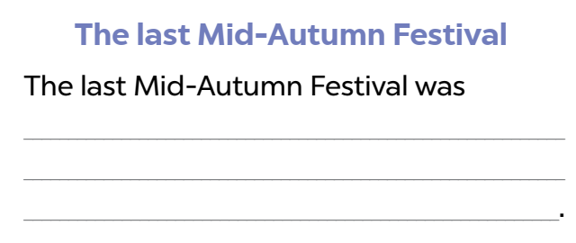
Look and read.
When was the festival?
What did you do there?
Where did you celebrate it?
What food and drinks did you have?
Notes:
Step 1: Tell the class the goal of this activity: to read the suggested questions, the word cues and write in the lines about the Autumn Festival. Tell pupils that they should write about 40 words. Check comprehension.

Slide 33

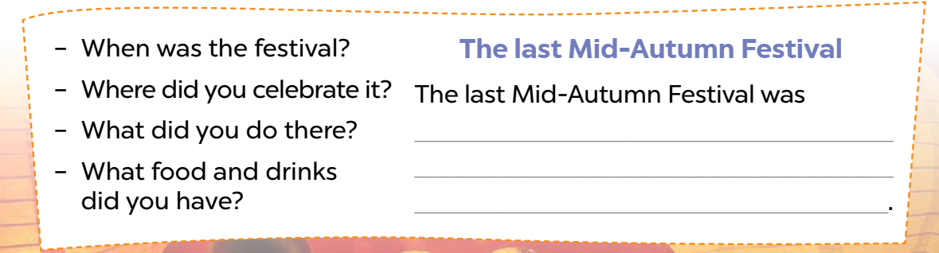
Let’s write.
When was the festival?
The last Mid-Autumn Festival
The last Mid-Autumn Festival
was _________________________.
in September
Notes:
Step 2: Write the first sentence with the gap on the board (Last Mid-Autumn Festival was ___). Read the sentence as a class. When you reach the gap, ask pupils to elicit the necessary information (the month when the last Mid-Autumn Festival was in) and write it down to complete the sentence.

Slide 34
Let’s write.
Where did you celebrate it?
The last Mid-Autumn Festival
The last Mid-Autumn Festival was in September.
It was _______________________.
in the school playground
Notes:
Step 3: Repeat Step 2 for the other questions on the left. Ask pupils to read the questions carefully and write the answer to complete the lines in the passage.

Slide 35
Let’s write.
What did you do there?
The last Mid-Autumn Festival
The last Mid-Autumn Festival was in September. It was in the school playground.
a lot of fun activities.
We had ______________________________
_____________________________________
_____________________________________
___________________________________.
Giang and Hoa sang a song. Linh and Phong danced together. Thu and I played hide-and-seek.
Notes:
Step 3: Repeat Step 2 for the other questions on the left. Ask pupils to read the questions carefully and write the answer to complete the lines in the passage.

Slide 36
Let’s write.
What food and drinks did you have?
The last Mid-Autumn Festival
The last Mid-Autumn Festival was in September. It was in the school playground. Giang and Hoa sang a song. Linh and Phong danced together. Thu and I played hide-and-seek.
chicken noodles and watermelon.
We ate ______________________________
____________________________________ .
We drank water and apple juice
Notes:
Step 3: Repeat Step 2 for the other questions on the left. Ask pupils to read the questions carefully and write the answer to complete the lines in the passage.

Slide 37
Read to your friends.
Notes:
Step 4: If time allows, invite a few pupils to read the sentences they have completed/written aloud in front of the class. The class observes and praises their work.

Slide 38
Read aloud in the front.
When was the festival?
What did you do there?
Where did you celebrate it?
What food and drinks did you have?
Notes:
Step 4: If time allows, invite a few pupils to read the sentences they have completed/written aloud in front of the class. The class observes and praises their work.

Slide 39
Good Job!
Congratulations!

Slide 40
5.
Fun corner and Wrap-up
LET'S START!

Slide 41









Number Race!
Play

Slide 42























1
2
3
4
5
10
30
20
10
30
END
Notes:
- Click the number to go to the Question slide.
Click the colored box to disappear the choice.
Cl

Slide 43







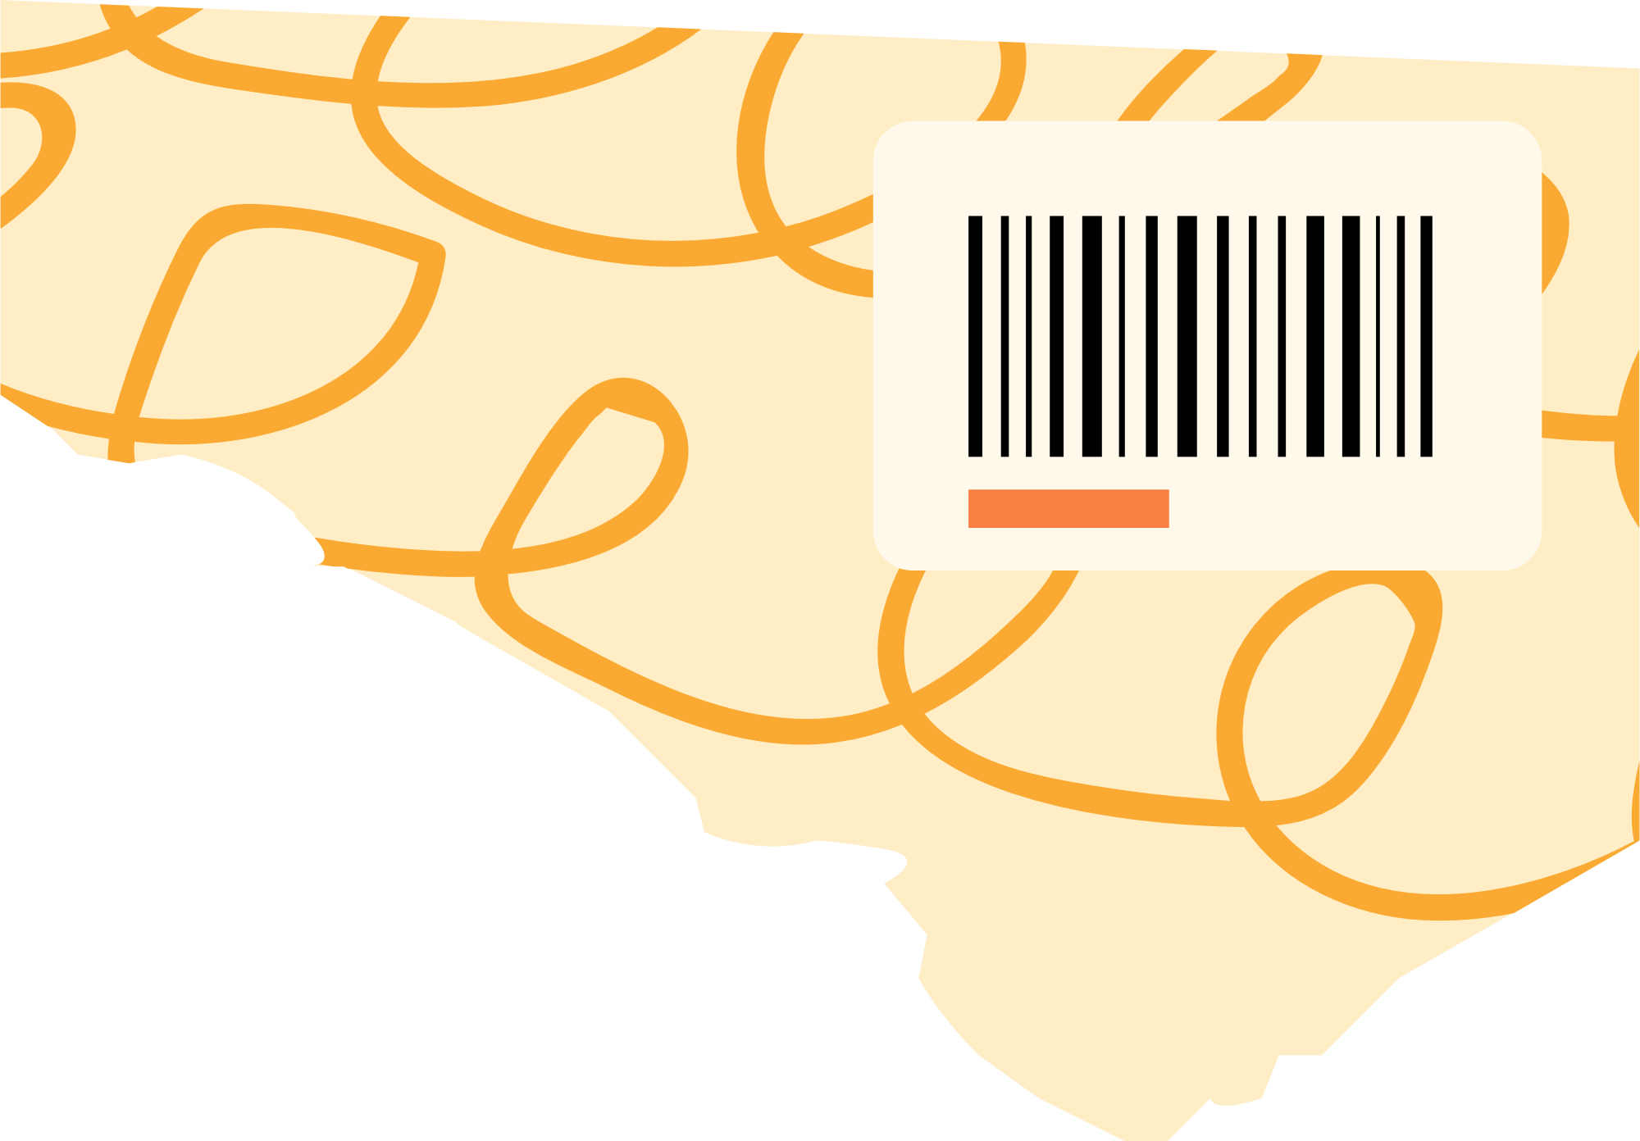
1
BACK TO GAME BOARD
How often does your father
play badminton?
ANSWER
10

Slide 44



1
BACK TO GAME BOARD
He plays badminton (twice a week).
10

Slide 45


2
BACK TO GAME BOARD
What did you do
last Mid-Autumn Festival?
ANSWER
30

Slide 46

2
BACK TO GAME BOARD
I (sang songs
and danced).
30

Slide 47



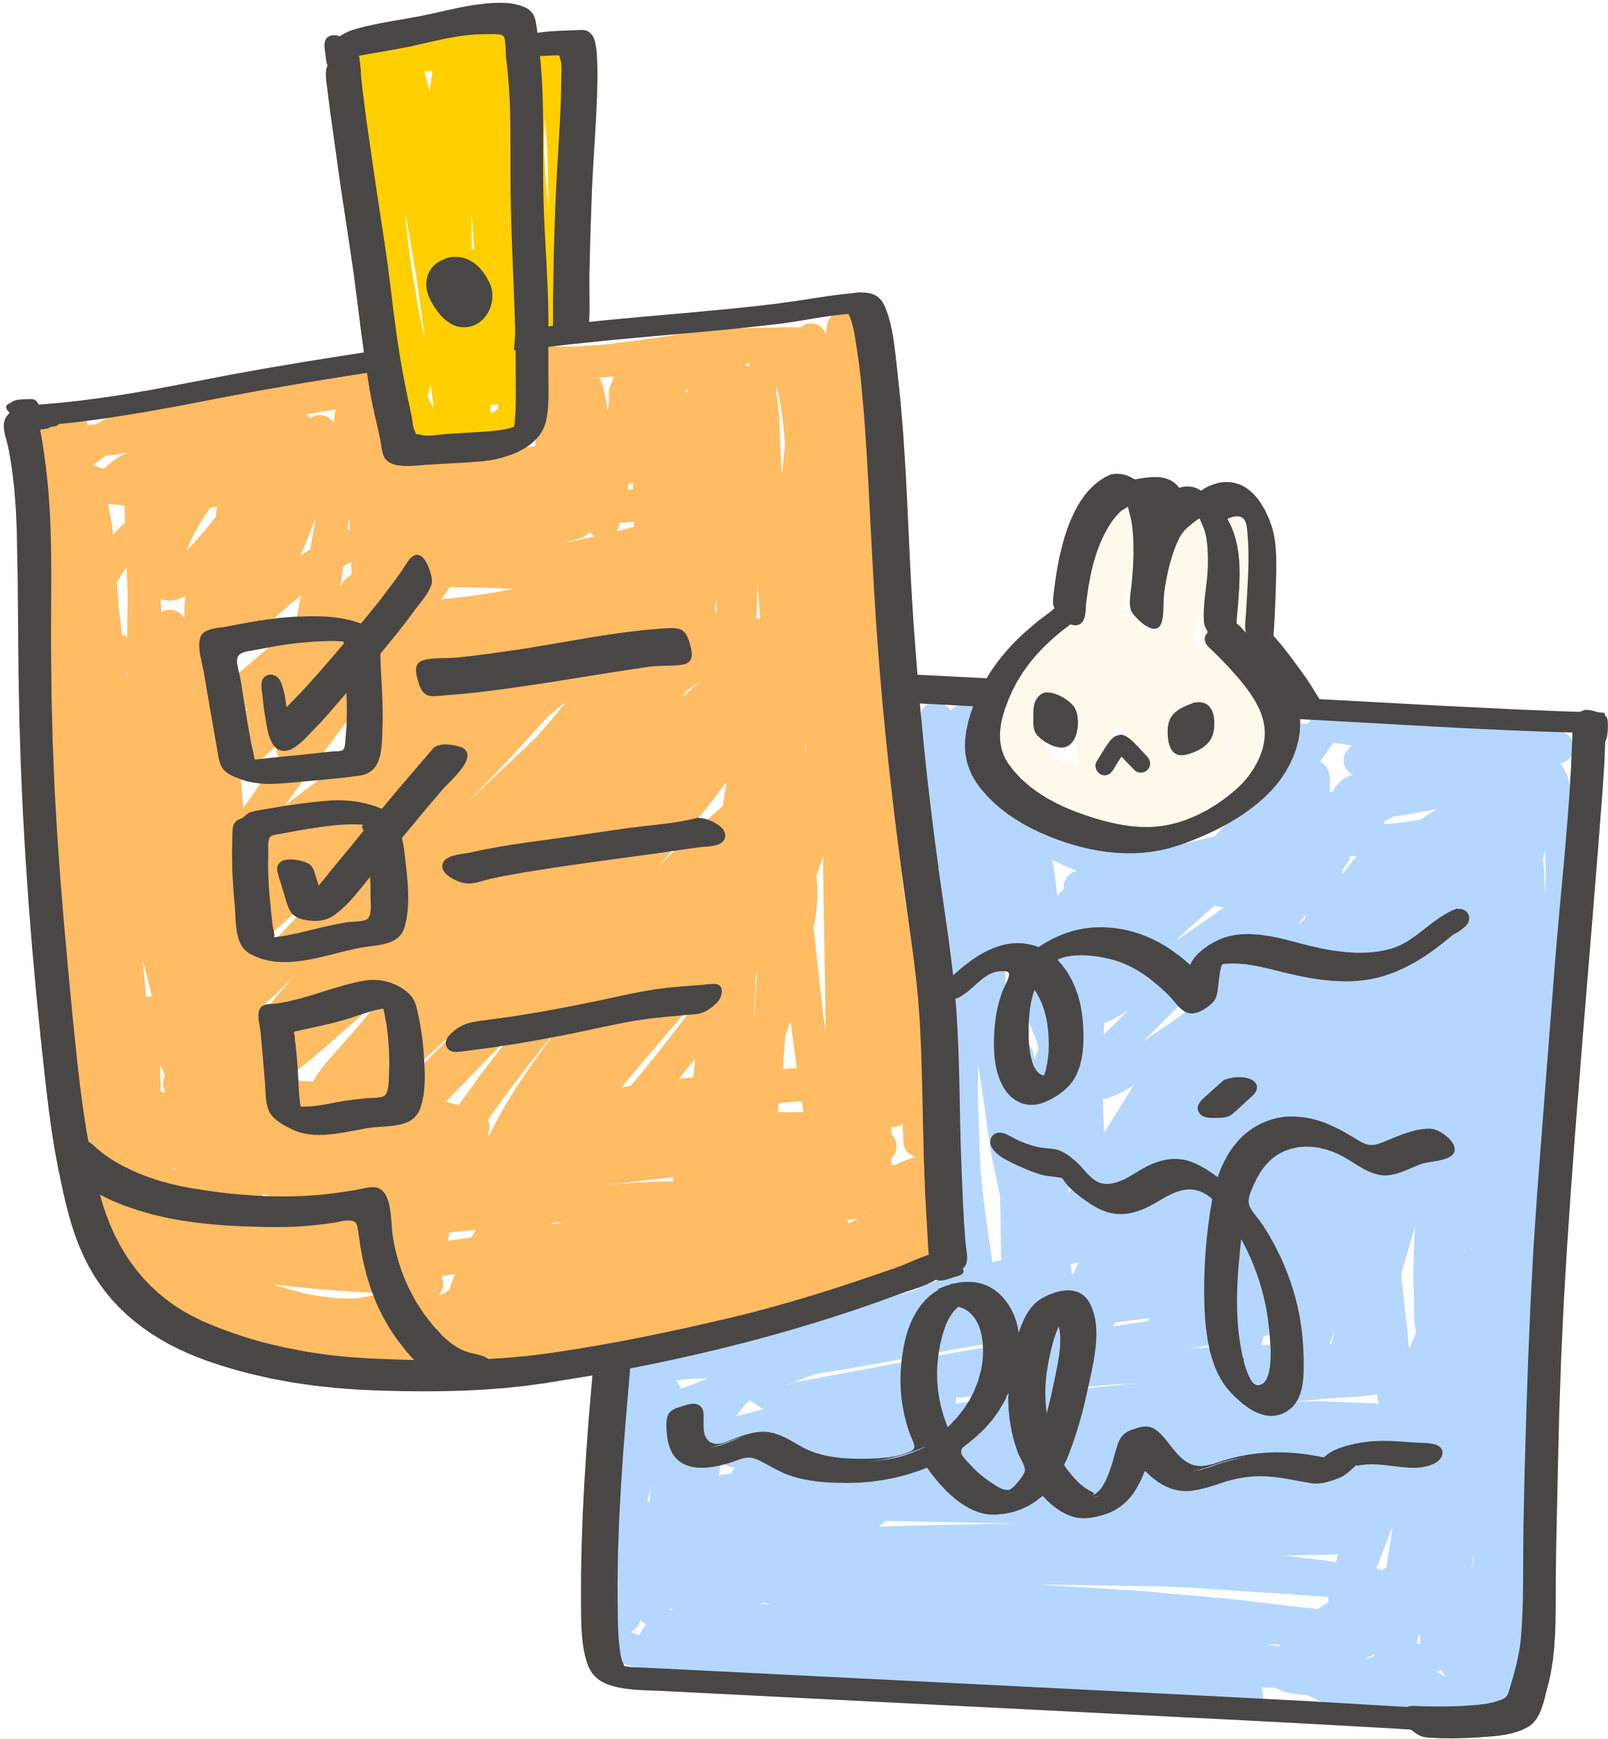


3
BACK TO GAME BOARD
What will you do
next summer?
ANSWER
20

Slide 48


3
BACK TO GAME BOARD
I will (go to the beach with my family).
20

Slide 49





4
BACK TO GAME BOARD
What did you eat
this morning?
ANSWER
10

Slide 50

4
BACK TO GAME BOARD
I ate (meat and rice).
10

Slide 51





5
BACK TO GAME BOARD
What will you drink tomorrow morning?
ANSWER
30

Slide 52

5
BACK TO GAME BOARD
I will drink (milk).
30

Slide 53
Good Job!
Congratulations!

Slide 54
Website: hoclieu.vn
Fanpage: https://www.facebook.com/tienganhglobalsuccess.vn/

